Slide 1
Predicting Happiness Score: The Role of Socio-Cultural and Political Factors in Regional Well-being COSC522 Final Project Presentation
Group 5
Almy, Britton
Gupta, Atul
Proctor, Mary
Rangel, Jarrod
Instructor: Dr. Joshua Fagan

Slide 2
Introduction
This project explores the use of machine learning and deep learning models to predict national happiness scores based on a broad set of socio-economic, cultural, and political indicators. Using data from the World Happiness Report, the study aims to identify which features most strongly influence well-being across countries and assess which predictive models provide the most accurate results.
Selection criteria
Publicly available dataset
Large enough dataset to use a smaller sampling
Temporal and Geographical Coverage
Feature Diversity
Data Source Credibility
Notes:
Our project investigates how machine learning and deep learning can be applied to predict happiness scores.
We’re using the World Happiness Report dataset, which captures self-reported well-being across nations.
The focus is on identifying which socio-political and cultural factors most influence happiness, and which models best predict it.
We selected the dataset based on its size, diversity, credibility, and coverage over time and geography.

Slide 3
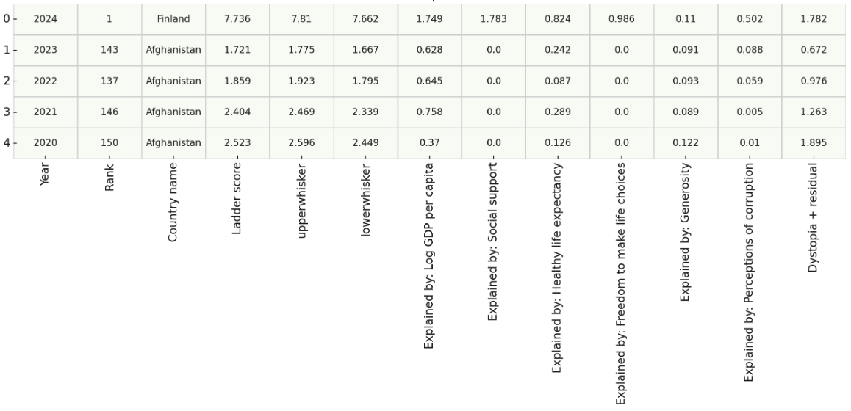
DataSet
Sourced from the World Happiness Report (2012–2024)
Movie Genre Classification Data Set
Key target variable: Ladder Score (subjective well-being on a 0–10 scale)
1,651 unique entries
13 columns
169 Unique Countries
13 Years
Notes:
The dataset spans 13 years (2012–2024) and includes data from 169 countries.
It contains 1,651 entries and 13 features including economic, health, and governance indicators.
Our target variable is the Ladder Score, which represents perceived well-being on a 0–10 scale.
This rich dataset enables both temporal and regional analysis of global happiness trends.

Slide 4
THE GOAL
Predict national happiness scores using machine learning and deep learning techniques based on a broad range of socio-economic, political, and cultural indicators.
Why This Matters
Happiness scores are used globally to inform policy, social investment, and well-being initiatives.
Machine learning allows us to model complex, non-linear relationships that traditional statistical methods may overlook.
Understanding key happiness drivers can support more targeted and effective public policy.
Notes:
Our goal is to use predictive modeling to estimate national happiness scores from other measurable indicators.
This matters because happiness metrics are being increasingly used to shape public policy.
Machine learning offers a way to model complex, nonlinear relationships between these variables, improving insight over traditional models.
Identifying key predictors can inform smarter investment in social, economic, and digital infrastructure.

Slide 5
APPROACH
Data Acquisition & Preprocessing
Cleaned missing values, standardized numerical features, one-hot encoded categorical variables
Exploratory Data Analysis (EDA)
Correlation heatmaps, histograms, and outlier detectionModel Development
Feature selection based on correlation and f_regression
Evaluation
Trained five regression models:
Linear Regression
Support Vector Regression (SVR)
Random Forest
XGBoost
Deep Learning Scalar Regression
Synthesis
Compiled individual findings
Analyzed top features and model consistency
Interpreted insights on global happiness prediction
Notes:
We followed a five-step methodology:
Data Cleaning: Removing or imputing missing values, encoding categoricals, and scaling numeric data.
EDA: Used correlation heatmaps and distributions to understand patterns and guide feature selection.
Modeling: Trained five regressors—Linear, SVR, Random Forest, XGBoost, and Deep Learning.
Evaluation: Used MAE, MSE, and R² to compare accuracy.
Synthesis: Compared individual findings across team members and models to ensure consistency and robustness.

Slide 6
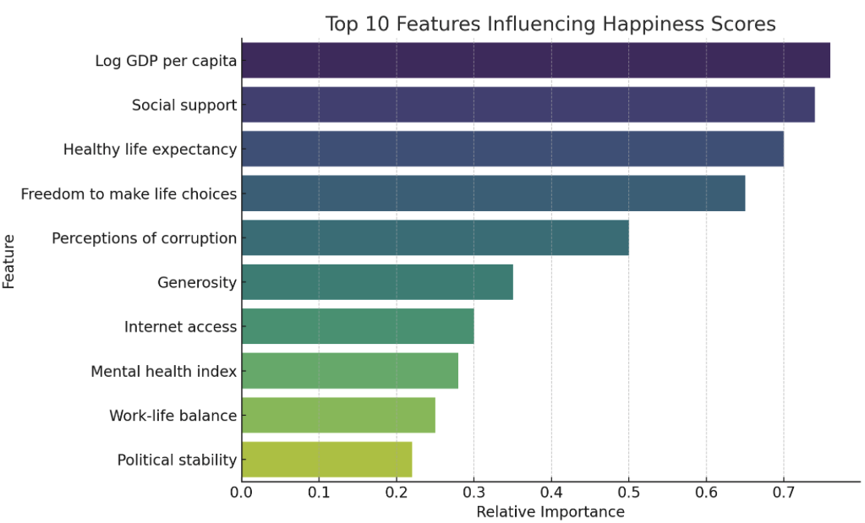
Feature Exploration
Identified features correlated with happiness scores (e.g., GDP, social support, life expectancy)
Additional features: Internet access, political stability, mental health, and work-life balance
Used correlation analysis and f_regression to rank feature importance
Notes:
We identified a core set of features consistently correlated with happiness, such as GDP, health, and social support.
We also explored broader indicators like internet access, mental health, and political stability.
Feature importance was ranked using correlation analysis and f_regression, giving us a solid foundation for model input.

Slide 7
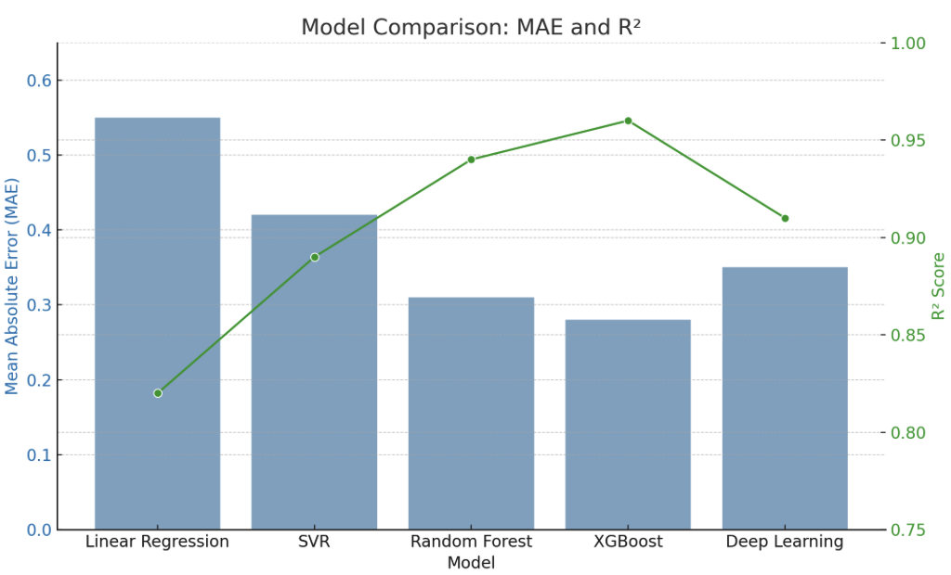
Model Comparison
Five models evaluated: Linear Regression, SVR, Random Forest, XGBoost, Deep Learning
Compared using MAE, MSE, and R² on test data
Best performance: XGBoost, followed by Random Forest and Deep Learning
Linear Regression had the weakest fit due to its linear assumption
Notes:
We evaluated five models across three metrics: MAE, MSE, and R².
XGBoost had the best overall performance—lowest error and highest R².
Random Forest and Deep Learning also performed well, while Linear Regression underperformed due to its simplicity.
These results suggest non-linear models capture the complexity of happiness better.

Slide 8
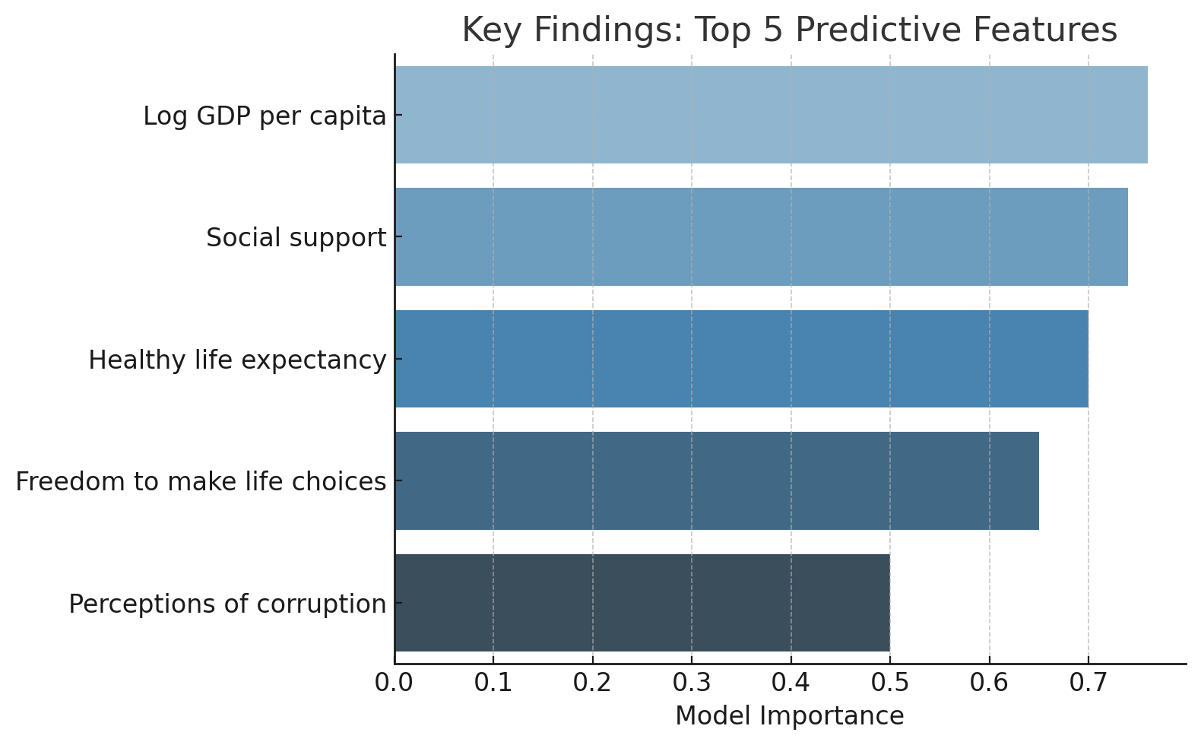
Key Findings
Wealth, social support, and health are strong predictors of happiness
Nonlinear models outperformed linear ones
Broader feature sets (mental health, internet access) improved accuracy
Deep learning showed promise but needs larger datasets to fully outperform tree-based models
Notes:
Strong predictors of happiness include GDP, social support, and life expectancy.
Broader features like internet access and work-life balance added predictive power.
Tree-based models outperformed linear ones, confirming the need for models that can capture feature interactions.
Deep learning shows promise, especially as data availability improves.

Slide 9
Data Limitations
Self-reported data introduces subjectivity
Not all countries have data for all years
Missing or proxy variables (e.g., quality of education, income mobility)
Some perception-based features (e.g., corruption, freedom) may lack objectivity
Notes:
The dataset relies on self-reported survey data, which introduces subjectivity.
Not all countries have full year coverage, leading to potential bias.
Some important factors like income mobility or education quality are missing or proxied.
Perception-based features (like corruption or freedom) are subjective and harder to validate.

Slide 10
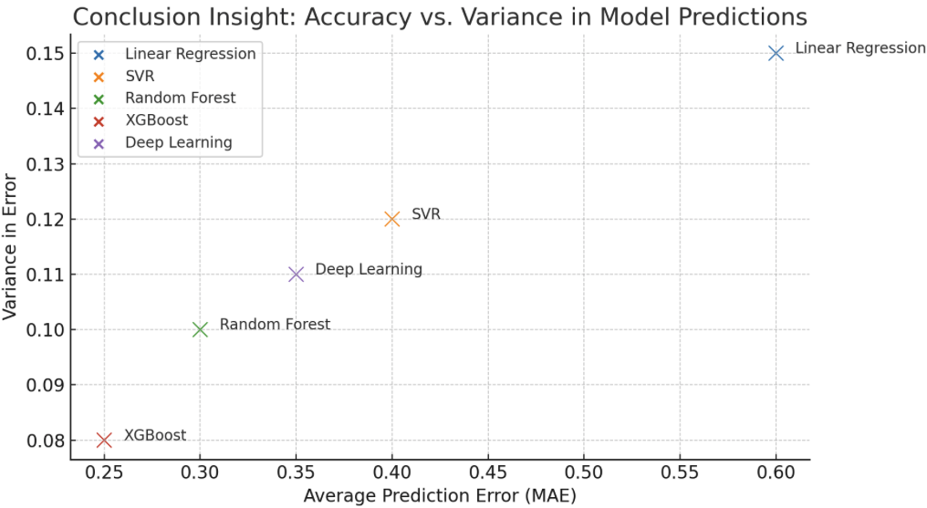
Conclusions
Advanced models can accurately predict happiness using socio-political and economic indicators
Findings support the value of investing in health, support systems, and digital inclusion
Results can guide policy design in areas like well-being, mental health, and social development
Notes:
Machine learning models can predict happiness with high accuracy using publicly available socio-economic indicators.
The results support the idea that digital inclusion, health, and social support are critical to well-being.
These models can help guide policy design, especially in areas where governments want to improve population happiness.

Slide 11
Next Steps
Expand dataset with regional or city-level happiness data
Explore time-series models for forecasting
Improve interpretability of deep learning models
Publish findings in policy or data science outlets
Notes:
Extend the dataset to include regional or city-level data for more granular analysis.
Introduce time-series models to capture changes and trends over time.
Improve the interpretability of deep learning models to gain more actionable insights.
Explore publishing the findings in academic or policy-focused venues.

Slide 12
Thank You!

